Slide 1

Working with Assistants Part 10: Finishing Working with Runs

Slide 2
What’s Covered in This Session
Retrieving Runs
Creating a Thread and Run Dynamically
Modifying Runs
Cancelling Runs

Slide 3
Retrieving Runs
Review How to Get Runs Back
Notes:
https://platform.openai.com/docs/api-reference/runs/getRun

Slide 4
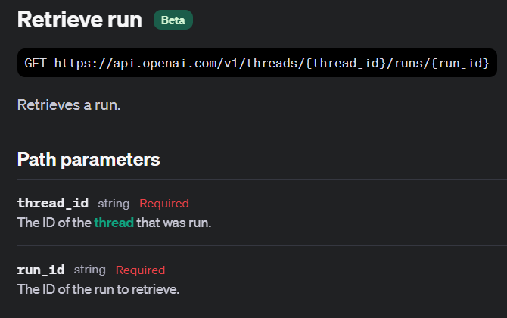

Slide 5
Demo: Retrieve Run
run = client.beta.threads.runs.retrieve(
thread_id=thread.id,
run_id=runs_list[0].id
)

Slide 6
Create Thread and Run
Helper Functions FTW!
Notes:
https://platform.openai.com/docs/api-reference/runs/createThreadAndRun

Slide 7
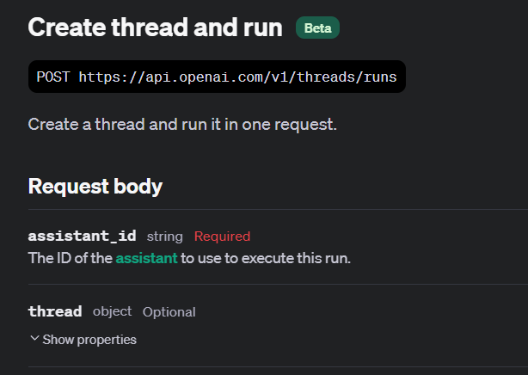

Slide 8
Demo: Create Thread and Run
run = client.beta.threads.create_and_run(
assistant_id=assistant.id,
thread={
"messages": [
{"role": "user", "content": "Explain deep learning to me like I'm a 5 year old."}
]
}
)

Slide 9
Modifying Runs
Change that Metadata
Notes:
https://platform.openai.com/docs/api-reference/runs/modifyRun

Slide 10
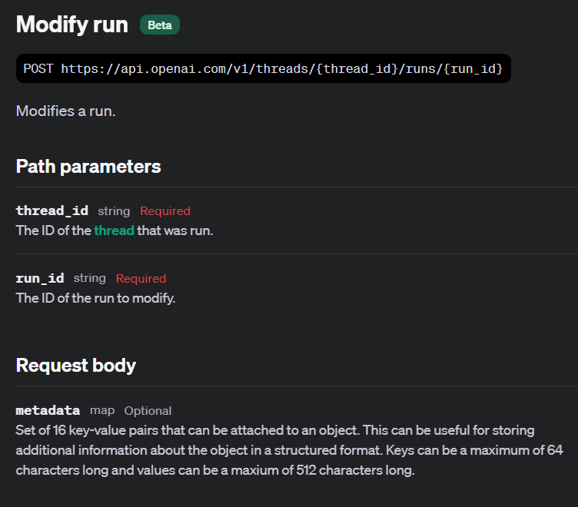

Slide 11
Demo: Modifying a Run
run = client.beta.threads.runs.update(
thread_id=run.thread_id,
run_id=run.id,
metadata={"user_id": "user_abc123"},
)

Slide 12
Canceling Runs
Stop the Run in Progress
Notes:
https://platform.openai.com/docs/api-reference/runs/cancelRun

Slide 13
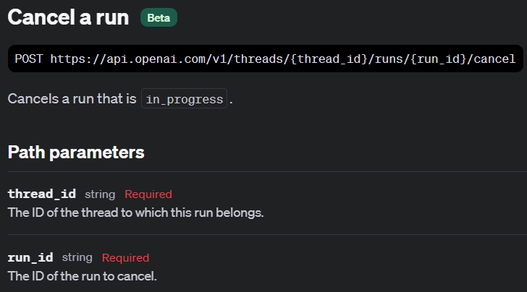

Slide 14
Demo: Cancelling a Run
for event in stream_run:
if hasattr(event.data, 'status'): # Check if 'status' is an attribute of the event data
print(event.data.id)
print(event.data.status)
if event.data.status == "in_progress":
print("Cancelling the run.")
cancelled_run = client.beta.threads.runs.cancel(thread_id=thread.id, run_id=event.data.id)
else:
print(f"Event ID: {event.data.id} does not have a status attribute.")
print(event.data.delta)
print("---------------\n")

Slide 15


